Slide 1
Waterfowl & Shorebird Identification
CTS Wildlife

Slide 2
Classifications
All ducks are divided into two categories:
Puddle Ducks
Diving Ducks

Slide 3
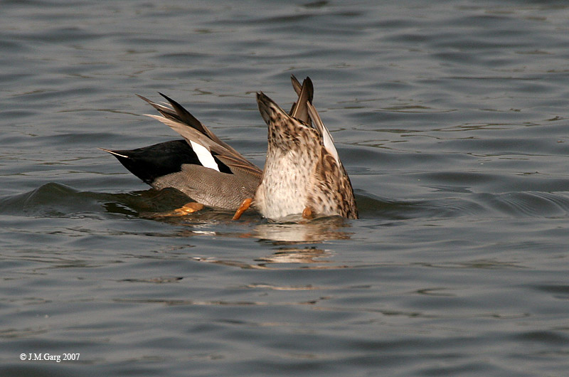
Puddle Ducks
Tip over to feed
Take off straight up off of the water
Their legs are situated more to the middle of their body

Slide 4
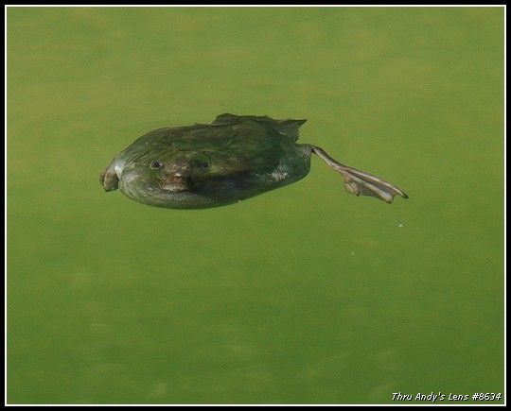
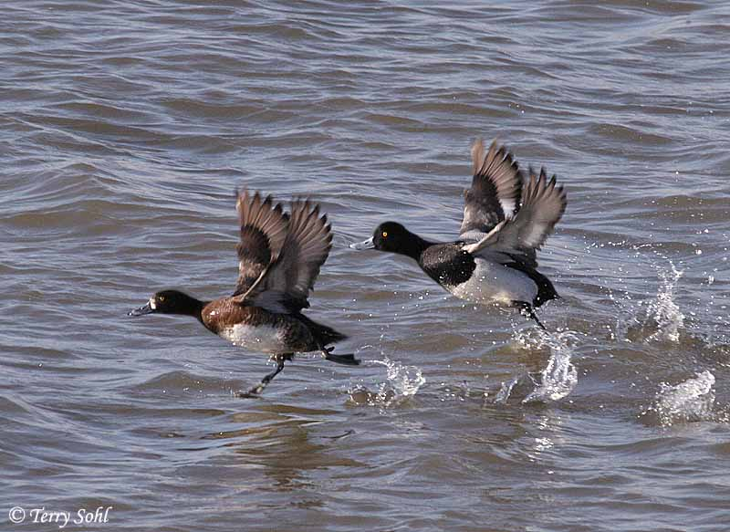
Diving Ducks
Dive for their food (some dive to 10 metres)
Legs are situated near the back of the body
Take off from the water by running along the surface

Slide 5
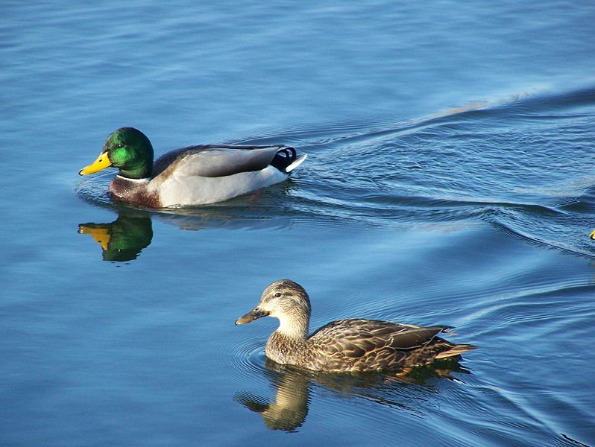
Mallard Duck

Slide 6
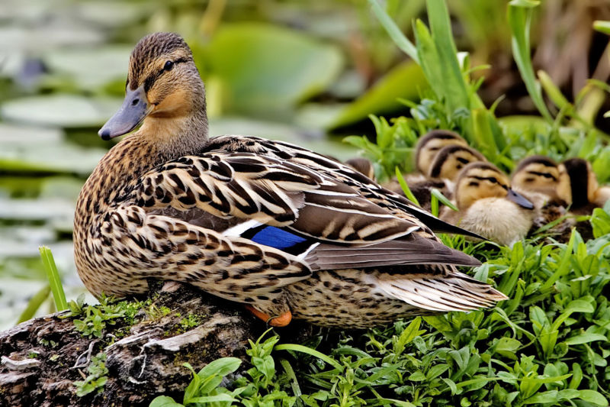

Slide 7
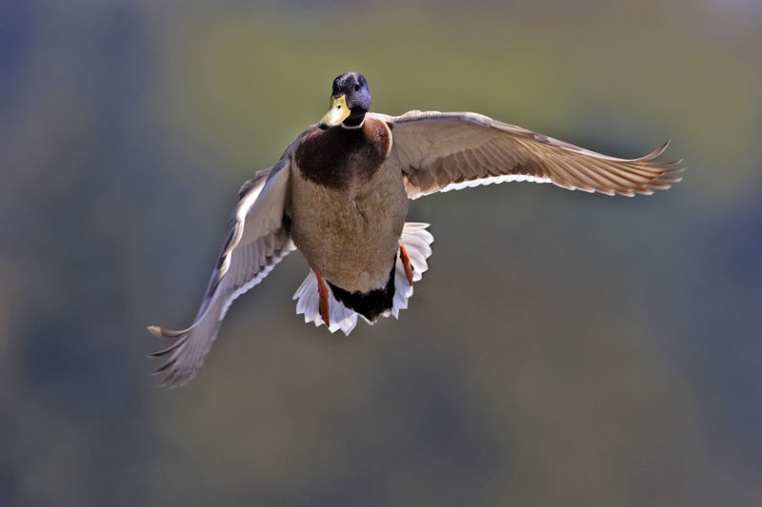

Slide 8
Northern Pintail

Slide 9
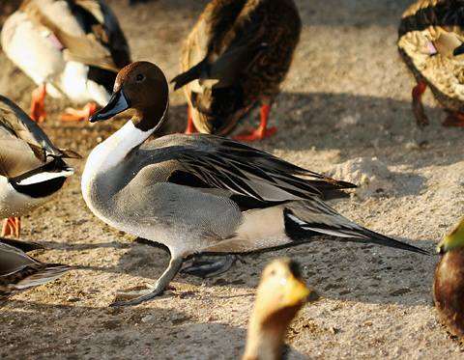

Slide 10
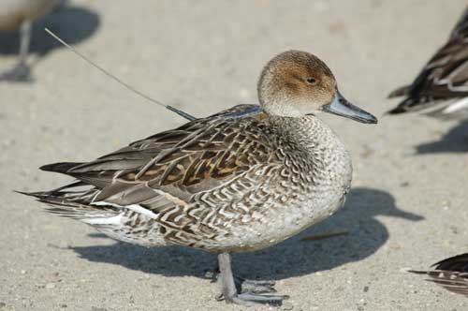

Slide 11
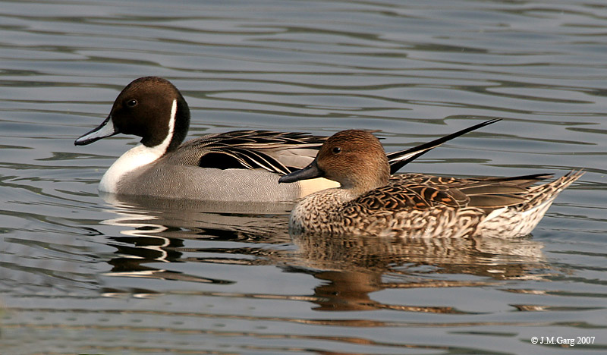

Slide 12
Greenwing Teal

Slide 13
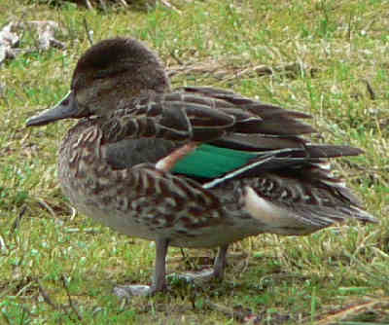

Slide 14
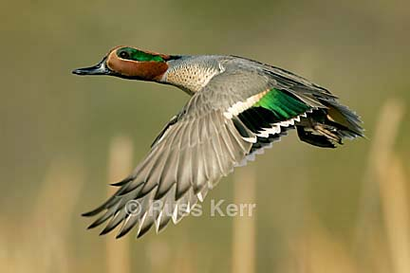

Slide 15
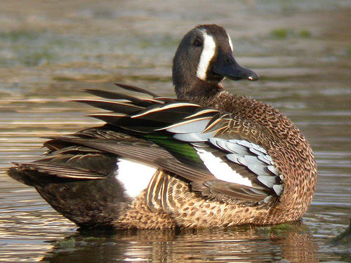
Blue Wing Teal

Slide 16
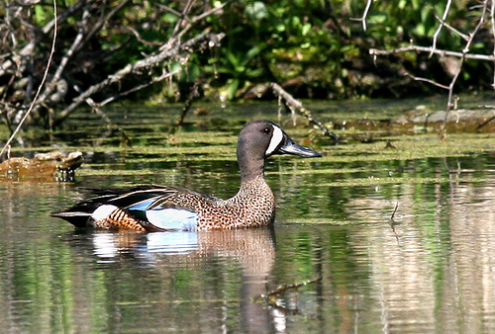

Slide 17
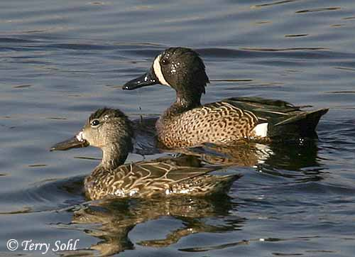

Slide 18
Cinnamon Teal

Slide 19
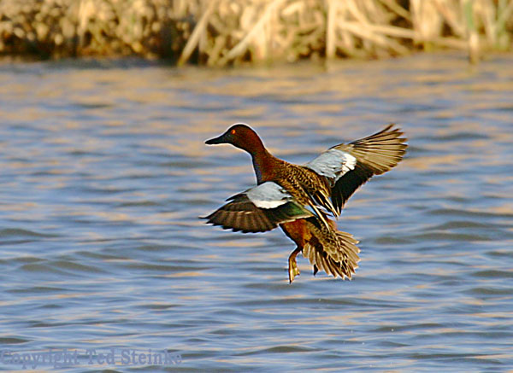

Slide 20
Northern Shoveler

Slide 21
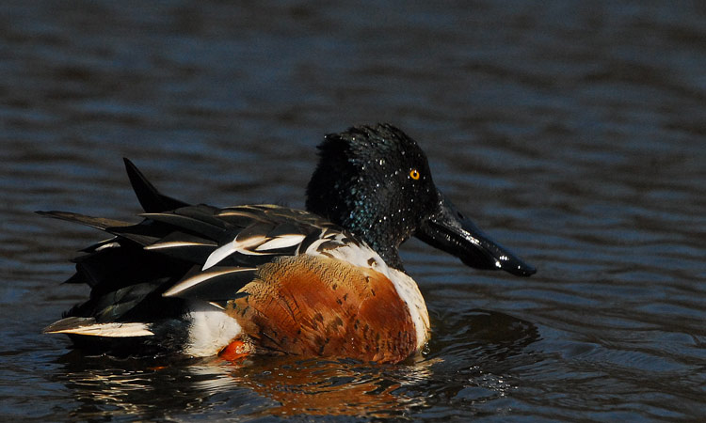

Slide 22
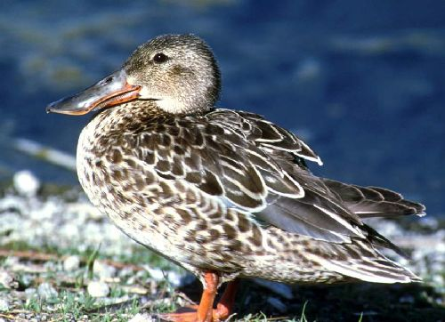

Slide 23
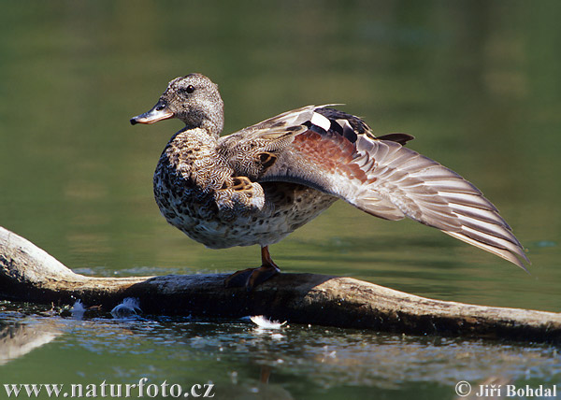
Gadwall

Slide 24
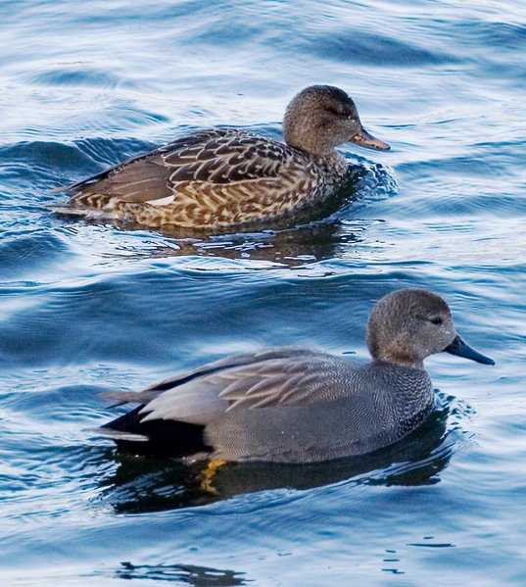

Slide 25
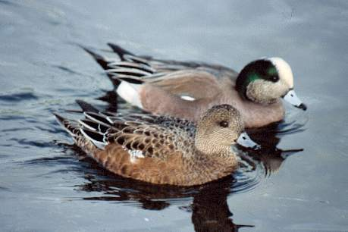
American Widgeon

Slide 26
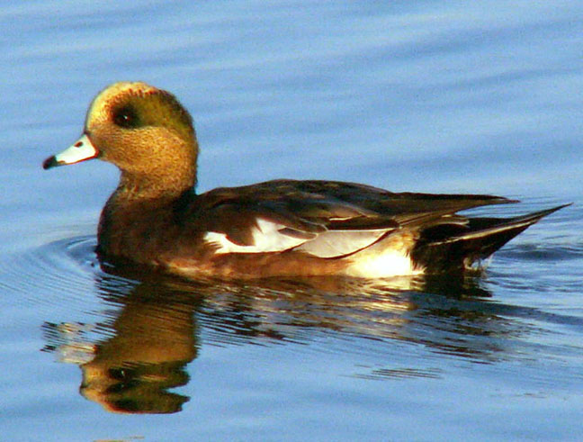

Slide 27
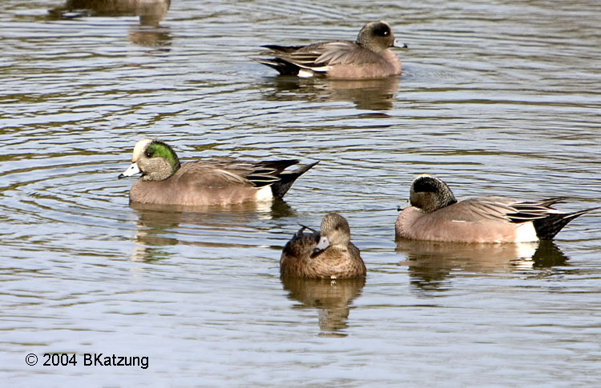

Slide 28
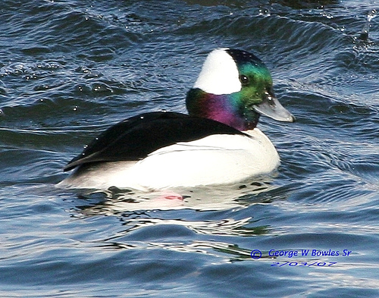
Bufflehead

Slide 29
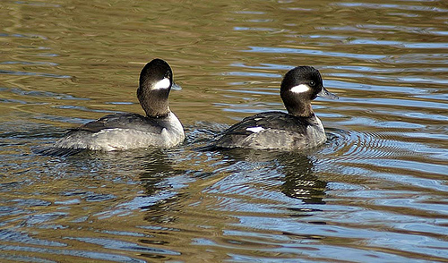

Slide 30
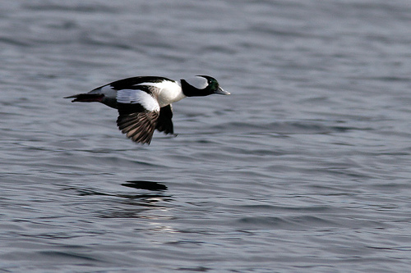

Slide 31
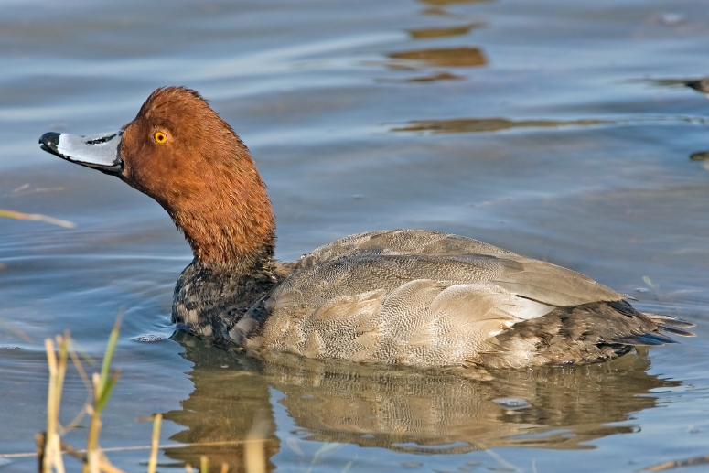
Red Head

Slide 32
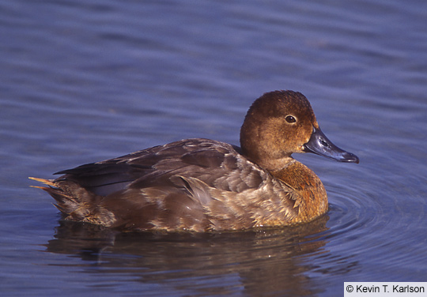

Slide 33
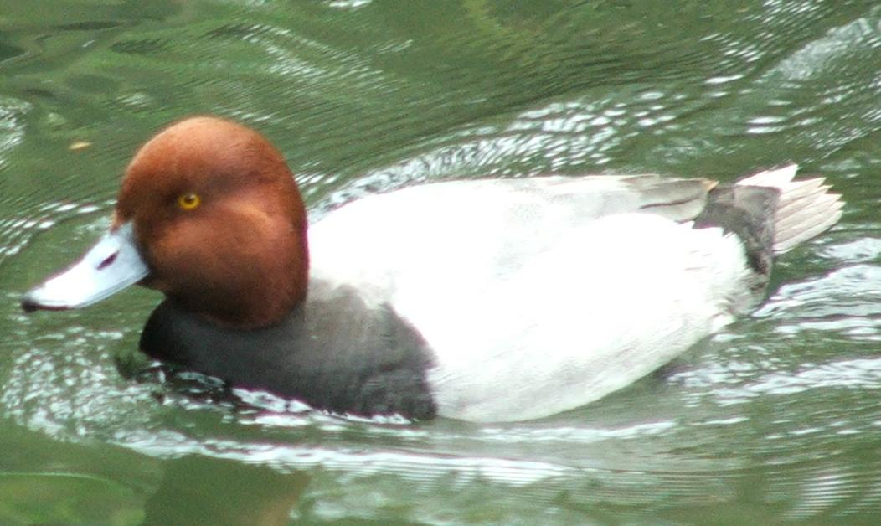

Slide 34
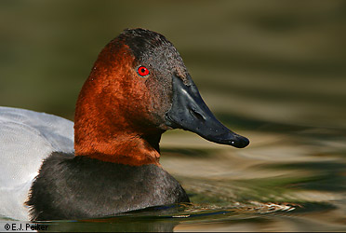
Canvasback

Slide 35
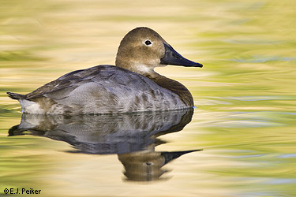

Slide 36
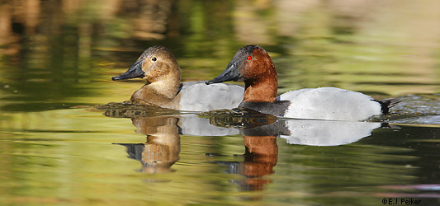

Slide 37
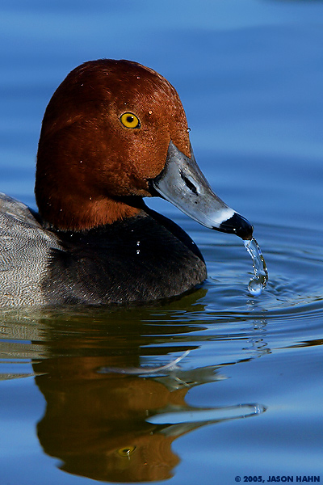
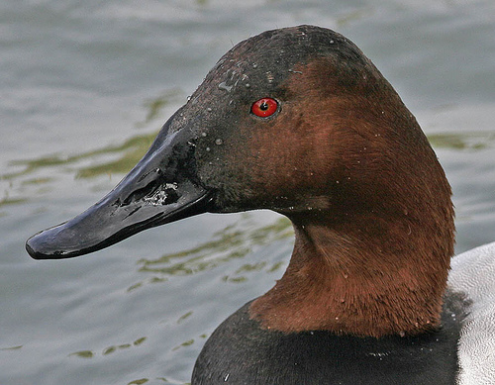

Slide 38
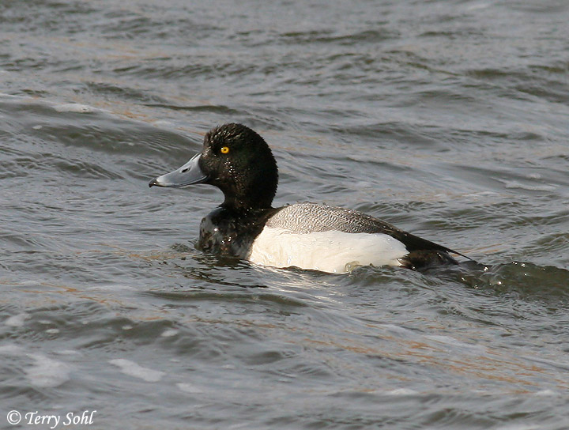
Lesser Scaup

Slide 39
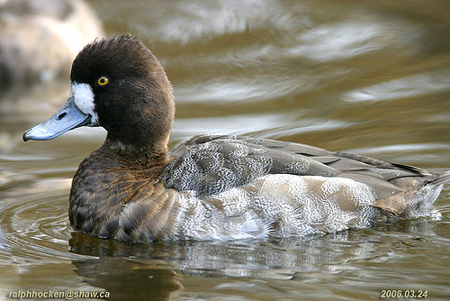

Slide 41
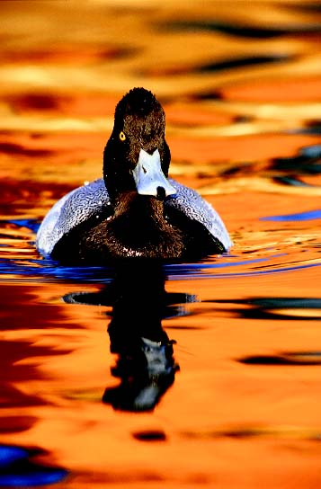

Slide 42
Ring Necked Duck

Slide 43
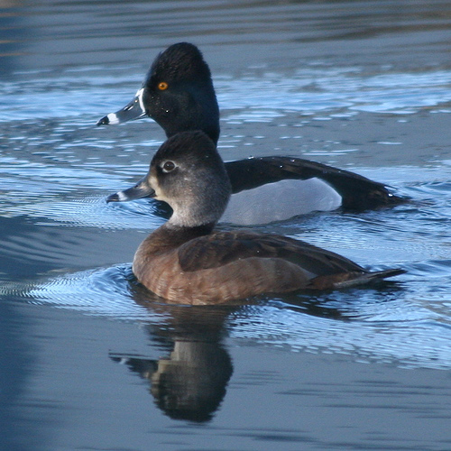

Slide 44
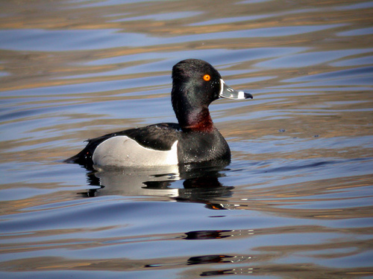

Slide 45
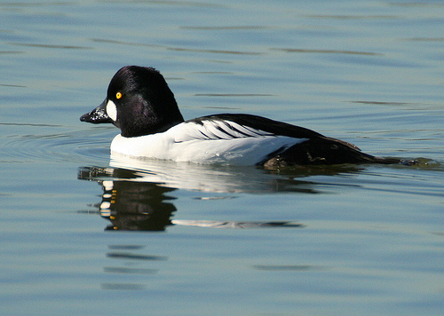
Common Goldeneye

Slide 46
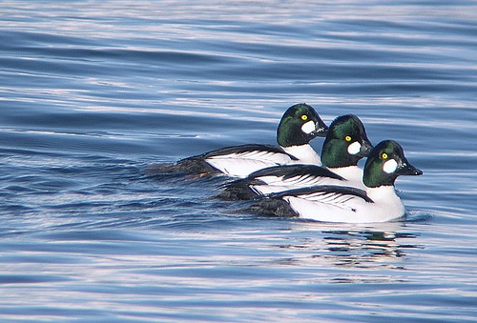

Slide 47
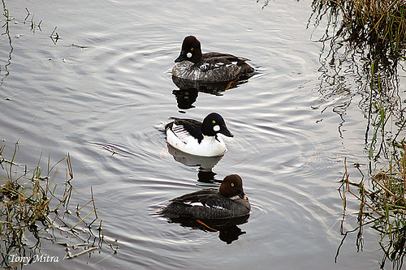

Slide 48
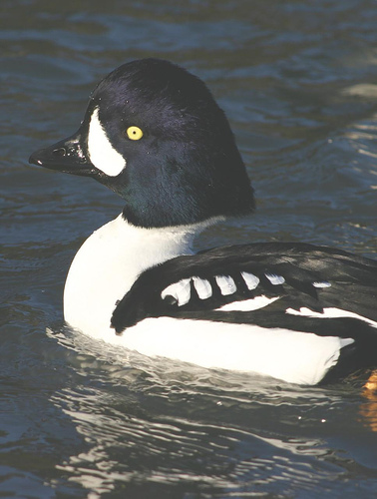
Barrows Goldeneye

Slide 49
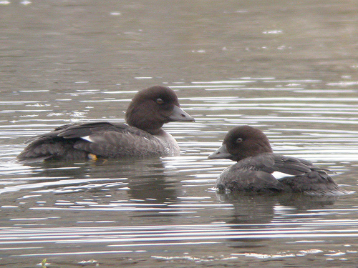

Slide 50
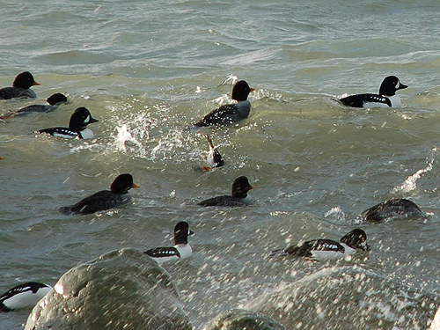

Slide 52
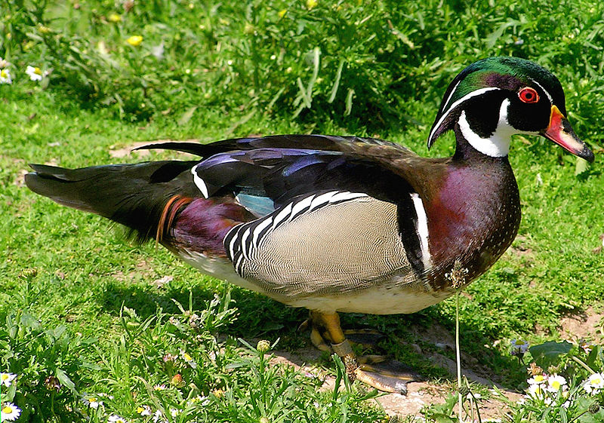
Wood Duck

Slide 53
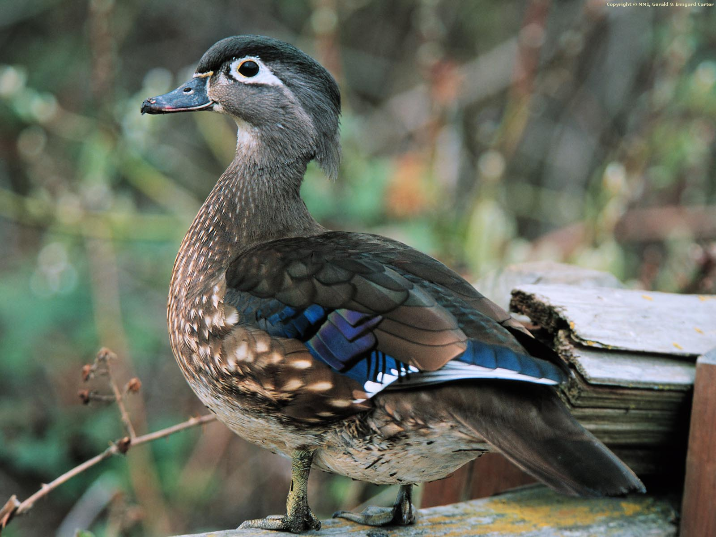

Slide 54
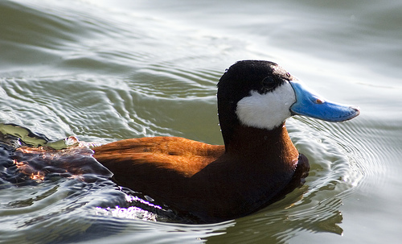
Ruddy Duck

Slide 55
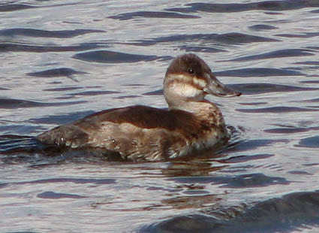

Slide 56
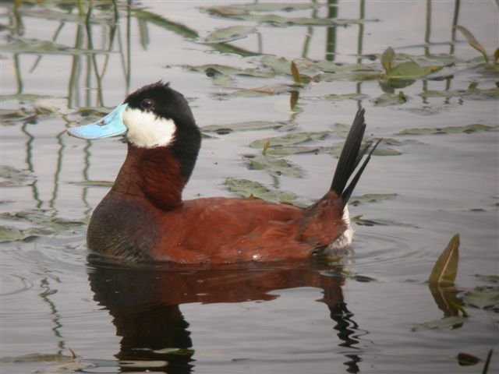

Slide 57
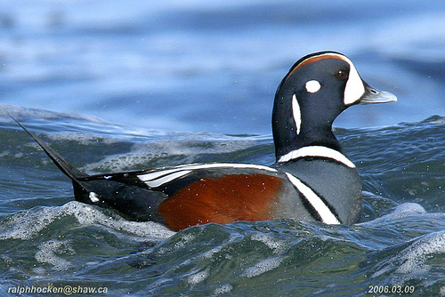
Harlequin Duck

Slide 60
Long Tailed Duck

Slide 63
Common Eider

Slide 66
King Eider

Slide 68
Surf Scoter

Slide 70
White winged Scoter

Slide 72
Black Scoter

Slide 74
Canada Goose

Slide 78
Snow Goose

Slide 81
Blue Goose

Slide 83
Ross’ Goose

Slide 86
White-fronted Goose

Slide 88
Trumpeter Swan

Slide 90
Tundra Swan

Slide 94
American Coot

Slide 96
American Avocet

Slide 98
Common Snipe

Slide 100
Willet

Slide 102
Killdeer

Slide 104
Sandpiper

